Slide 1
CSESA
presents

Slide 2

LEARN
TO
CODE

Slide 3
INTRODUCTION
TO
{OOP}
O – Object
O – Oriented
P – Programming

Slide 4

WHAT
IS
OOP?

Slide 5
What is OOP?
It is an approach that provides a way of MODULARIZING program by creating PARTITIONED MEMORY area for both data and methods.
OOP is a new way of organizing code and data that provides increased RELIABILITY and excellent control over COMPLEXITY of software development process.
OOP contains OBJECTS and CLASSES.

Slide 6
ADVANTAGES
APPLICATIONS
Data Hiding
Inheritance
Real-World problems
Partition the work
Easily Upgraded
Object Oriented Databases
Real-Time systems
CAD systems
Artificial Intelligence

Slide 7
DIFFERENCE B/W POP & OOP
PROCEDURE ORIENTED PROGRAMMING
OBJECT ORIENTED PROGRAMMING
Emphasis on algorithm
Programs are divided into function.
Data moves openly around the system from function to function.
Most of the function share global data. Data is not hidden.
Follows TOP-DOWN approach.
POP doesn’t contain classes , objects.
Emphasis on data rather than procedure.
Programs are divided into OBJECTS
Data doesn’t allow to freely around the system
Maximum data items are private. Data is HIDDEN.
Follows bottom up approach.
OOP contains classes , objects.

Slide 8

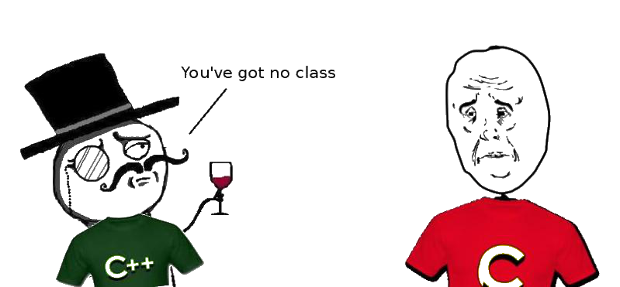
C is Procedure Oriented Programming language
C++ is Object Oriented Programming language

Slide 9
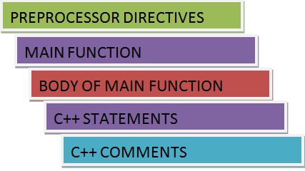
Structure of C++

Slide 10
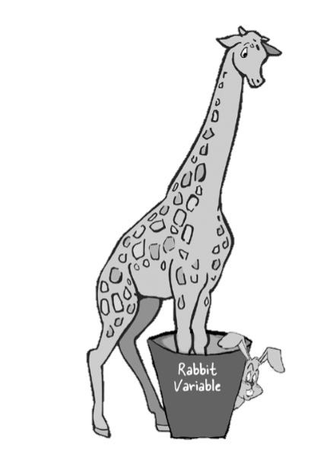
VARIABLES
Variable is a quantity whose value changes continuously throughout the program execution.
TYPES OF VARIABLE
NUMERIC VARIALBES: These are used to represent numeric constants.
CHARACTER VARIABLES: These are used to represent single character value.
STRING VARIABLES: These are used to represent string values.
C++ cares about type, you can’t put Giraffe in a rabbit variable.

Slide 11
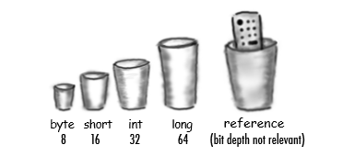
DATA TYPES
DATA TYPE | SIZE (IN BYTES) | RANGE
short int | 2 | -32,768 to 32,767
unsigned short int | 2 | 0 to 65,535
unsigned int | 4 | 0 to 4,294,967,295
int | 4 | -2,147,483,648 to 2,147,483,647
long int | 4 | -2,147,483,648 to 2,147,483,647
unsigned long int | 4 | 0 to 4,294,967,295
long long int | 8 | -(2^63) to (2^63)-1
unsigned long long int | 8 | 0 to 18,446,744,073,709,551,615
signed char | 1 | -128 to 127
unsigned char | 1 | 0 to 255
float | 4
double | 8
long double | 12

Slide 12
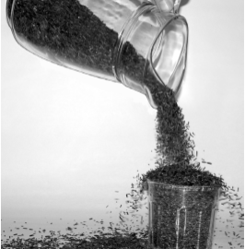
Just see…
The compiler wont let you put a value from a large cup into a small one .But what about the other way-pouring a small cup into a big one?.....no problem

Slide 13
KEYWORDS
ASM | DOUBLE | NEW | SWITCH | AUTO | ELSE | OPERATOR | TEMPLETE
ENUM | BREAK | PRIVATE | THIS | CASE | EXTERN | PROTECTED | THROW
CATCH | FLOAT | PUBLIC | TRY | CHAR | FOR | REGISTER | TYPEDEF
CLASS | FRIEND | RETURN | UNION | CONST | GOTO | SHORT | UNSIGNED
IF | VOID | VIRTUAL | DEFAUT | INLINE | SIZEOF | CONTINUE | DELETE
DO | LONG | STRUCT | WHILE | INT | SIGNED | STATIC | VOLATILE

Slide 14
BINARY OPERATOR:
Assignment Operator | +=, -=, *=, /=, &=
Arithmetic Operator | + , - , *, %,/
Relational Operator | < ,> , >= ,<= ,== ,!=
Boolean Logical Operator | & ,! , | ,^ , &&
Bitwise Operator | << ,>> ,&= ,|=
UNARY OPERATOR:
Increment | + +
Decrement | - -
TERNARY OPERATOR:
Conditional Operator | ? :

Slide 15
CONTROL
STATEMENTS

Slide 16
IF- ELSE:
SYNTAX:
True
False
CONDITION
if(condition)
{
//body
}
else
{
//body
}
EXECUTE IF STATEMENT
EXECUTE ELSE STATEMENT
EXECUTE STATEMENT AFTER IF-ELSE

Slide 17
PROGRAM:
//illustration of if-else statement
#include<iostream.h>
#include<conio.h>
void main()
{
clrscr();
int a=10,b=20;
if(a>b)
{
cout<<"a is greater";
}
else
{
cout<<"b is greater";
}
getch();
}

Slide 18
NESTED IF-ELSE
SYNTAX :
IF CONDITION 2
If (condition-1)
{
statement-1;
}
Else
{
if(condition-2)
{
statement-2;
}
else
{
statement-3;
}
}
No
Yes
IF CONDITION 2
STATEMENT 1
No
Yes
STATEMENT 3
STATEMENT 2

Slide 19
PROGRAM:
//illustration of if-else statement
#include<iostream.h>
#include<conio.h>
void main()
{
clrscr();
int a=10,b=20,c=5;
if(a>b)
{
if(a>c)
{
cout<<"a is the largest";
}
else
{
cout<<"c is the largest";
}
}
else
{
if(b>c)
{
cout<<"b is the largest";
}
else
{
cout<<"c is the largest";
}
}
getch();
}

Slide 20
WHILE:
SYNTAX :
CONDITION
No
Yes
Initialization;
While(condition)
{
//body
}
BODY OF WHILE
EXECUTE STATEMENT AFTER WHILE LOOP

Slide 21
PROGRAM:
//illustration of while loop
#include<conio.h>
#include<iostream.h>
void main()
{
clrscr();
int i=1;
while(i<=5)
{
cout<<"The value of i:"<<i<<endl;
i++;
}
getch();
}

Slide 22
DO WHILE:
SYNTAX :
EXECUTE THE DO CONTROLLED STATEMENT
Initialization;
Do
{
statement block;
}
while(condition);
Yes
CONDITION
No
EXECUTE STATEMENT AFTER DO-WHILE LOOP

Slide 23
PROGRAM:
//illustration of do while loop
#include<conio.h>
#include<iostream.h>
void main()
{
clrscr();
int i=1;
do
{
cout<<"The value of i:"<<i<<endl;
i++;
}while(i<=5);
getch();
}

Slide 24
FOR
INITIALIZE
SYNTAX :
NO
CONDITION
for(initialization; condition; increment/decrement)
{
statement;
}
Yes
BODY
INCREMENT / DECREMENT

Slide 25
PROGRAM:
//illustration of for(array) loop
#include<conio.h>
#include<iostream.h>
void main()
{
clrscr();
int a[5]={1,3,7,8,9};
for(int i=1;i<=5;i++)
{
cout<<"The value of a[i]:"<<a[i]<<endl;
}
getch();
}

Slide 26
SWITCH
true
SYNTAX:
Case 1
Case 1 action
break
switch (condition)
{
case 1:
statement 1;
break;
case 2:
statement 2;
break;
……..
default:
default block;
}
false
Case 2
true
Case 2 action
break
false
Case n
true
Case n action
break
false
Default actions

Slide 27
PROGRAM OF SWITCH – CASE
//illustration of switch case
#include<conio.h>
#include<iostream.h>
void main()
{
clrscr();
char op;
float n1,n2;
cout<<"Select Operation :";
cin>>op;
cout<<"Enter two numbers :";
cin>>n1>>n2;
switch(op)
{
case '+':
cout<<n1+n2;
break;

Slide 28
case '-':
cout<<n1-n2;
break;
case '*':
cout<<n1*n2;
break;
case '/':
cout<<n1/n2;
break;
case '%':
cout<<n1%n2;
break;
default:
//execute if none of the above operation is selected
cout<<"Error";
break;
}
getch();
}

Slide 29
CLASSES
Class is a collection of similar type of objects.
It is a collection of data members(variables) and member function(functions).
It is a user-defined data type.
Once a class is defined, we can create any number of objects.

Slide 30
OBJECTS
Object is an instance of class.
Object are the basic RUN-TIME entities in object oriented system.
Objects are the variables of the type class.
They may represent USER-DEFINED data.
Each object contains DATA and FUNCTION to manipulate the data.

Slide 31
OBJECT A
OBJECT B
DATA
DATA
FUNCTIONS
COMMUNICATION
FUNCTIONS
OBJECT C
DATA
FUNCTIONS

Slide 32
FUNCTION / METHOD
A Function is a group of Statements that together perform a task .
Functions can divide a code into separate small parts.
SYNTAX:
return_type function name( parameter list)
{
//body of the function
}

Slide 33
#include<iostream.h>
#include<conio.h>
class Test //class declaration
{
public: //access modifier
string name;
void funct() //function declaration
{
cout<<"ENTERED NAME IS"<<name;
}
};
void main()
{
Test t1,t2; //object created
t1.name= "CSESA";
t2.name="INCODE WE TRUST";
t1.funct(); //function call
t2.funct();
}

Slide 34


You might don’t know… but God is an OOP’s programmer…
Wanna know how!!
Let’s see
Excited!!

Slide 35


1.
First comes the classes he created
He first created a class called Human. Added some attributes and functions. Attributes such as eyes, ears, brain, legs. Functions such as walk, talk, think, sleep etc.
Class

Slide 36

2.
Then comes the two main subclasses: Man and Woman
He next created 2 sub classes - Man and Woman.
They inherited the attributes and functions of class human. However he added some attributes and functions specific to these classes. For the man and the woman class, he added attributes specific to their anatomy.
Like a special Adam's apple for the man, the breasts for the woman and a few other specific ones. He added functions specific to these classes, for instance he gave the function "GiveBirthToNewHuman" to the woman class. It was a complex function intended to spawn new objects and he did a great job there.
Inheritance

Slide 37


3.
And next are the different functions that we perform - Polymorphism
God gave both classes some polymorphic capabilities wherein they could act differently based on the input given.
For instance, the function "ConsumeThroughMouth" could behave differently based on the type of input given.
If food was given, the function has extra logic to use the teeth to grind it.
It milk or water was given, the function used the lips in a pout shape instead of using the teeth.
So different use of attributes. He also brought in a new associated term called function overloading as he was overloading multiple capabilites onto the function "ConsumeThroughMouth"

Slide 38

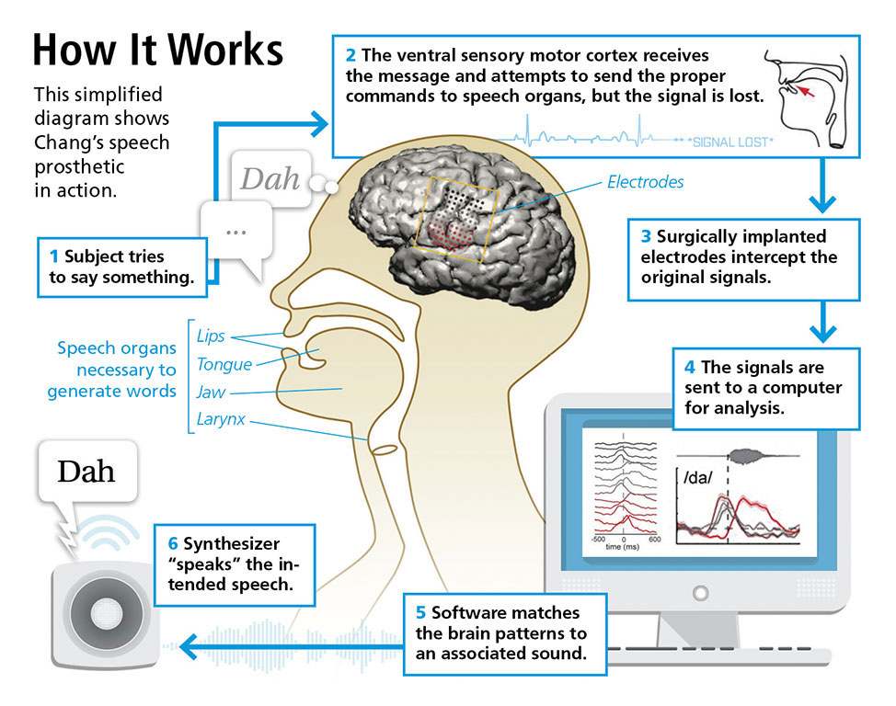
4.
Then comes the two main subclasses: Man and Woman
God thought it would be good if not many details and only what was necessary was given to the external world.
For instance the woman and the man can talk.
Abstraction
The internal details of how the neural network in the brain processed the signals received and in turns sends a signal to produce a sound is not exposed to the recepient or the outside world.

Slide 39

5.
Then comes the two main subclasses: Man and Woman
God's idea of combining the data and functions together to make it a working unit. God patented it with a fancy name "Encapsulation" for that, since he was on a roll with the names already - polymorphism, abstraction and what not!
Encapsulation

Slide 40


6.
Let’s Learn about the object’s God created…
Finally, it was time to have some fun, and create some instances of the classes made. And viola, God created Ajinkya, Yash, Tejashree, Shruti, Dimpal and many many more. And that's how this OOPS programmer created Human Life.
Objects

Slide 41

Inheritance
1
Look for objects that have common attributes and behaviours
Lion
Dog
Wolf
Cat
//state
//behaviour
//state
//behaviour
//state
//behaviour
//state
//behaviour
Is it that simple!!
2
Design a class that represents the common state and behavior.
Animal
Food
Hunger
location
makeNoise()
eat()
Sleep()

Slide 42

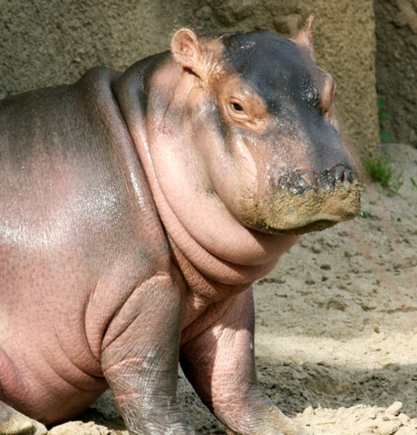

Why would I sound and eat like this hippo!!
3
Decide if a subclass needs behaviours that are specific to that particular subtype
Whatever
!!
So, let’s override these two methods, eat() and makeNoise(), so that each animal type can define its own specific behaviour.
For now, it looks like sleep() and roam() can stay generic.

Slide 43


4
Look for more opportunities to use abstraction, by finding two or more subclasses that might need common behaviour.
5
Finish the class hierarchy
Finally Done!!
e.g.: Canines could use a common roam() method, because they tend to move in packs.
You can use the dot operator on the reference variable to invoke all methods.

Slide 44
Access Modifiers :
Public:
All the class members declared under public will be available to everyone.
The data members and member functions declared public can be accessed by other classes too.
The public members of a class can be accessed from anywhere in the program using the direct member access operator (.) with the object of that class.

Slide 45
Private:
The class members declared as private can be accessed only by the functions inside the class.
They are not allowed to be accessed directly by any object or function outside the class.

Slide 46
Protected:
Protected access modifier is similar to that of private access modifiers, the difference is that the class member declared as Protected are inaccessible outside the class but they can be accessed by any subclass(derived class) of that class.

Slide 47

Single Inheritance:
In single inheritance, a class is allowed to inherit from only one class. i.e. one sub class is inherited by one base class only.
Syntax:
class subclass_name : access_mode base_class
{
//body of subclass
};
Class A
(Base Class)
Let’s relate this to our real life…
Sounds fun!!
Class B
(Derived Class)

Slide 48

// C++ program to explain Single inheritance
#include <iostream>
using namespace std;
// base class
class Vehicle
{
public:
Vehicle()
{
cout << "This is a Vehicle" << endl;
}
};
// sub class derived from two base classes
class Car: public Vehicle
{
};
// main function
int main()
{
// creating object of sub class will
// invoke the constructor of base classes
Car obj;
return 0;
}
Output:
This is a vehicle
Parent Class
Derived Class
Inheritance

Slide 49
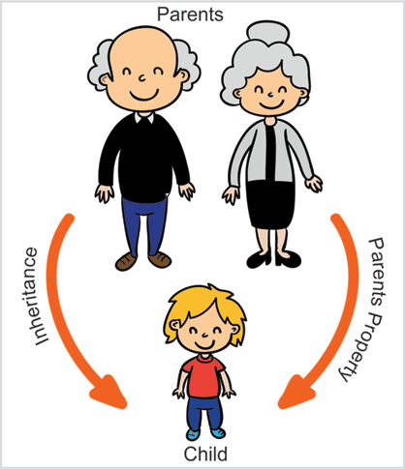
Multiple Inheritance:
(Base Class 1)
Class A
Class A
(Base Class 2)
Class B
(Derived Class)
Syntax:
class subclass_name : access_mode base_class1, access_mode base_class2, ....
{
//body of subclass
};
Multiple Inheritance is a feature of C++ where a class can inherit from more than one classes. i.e. one sub class is inherited from more than one base classes.

Slide 50
#include<iostream>
using namespace std;
class A
{
public:
A() { cout << "A's constructor called" << endl; }
};
class B
{
public:
B() { cout << "B's constructor called" << endl; }
};
class C: public B, public A // Note the order
{
public:
C() { cout << "C's constructor called" << endl; }
};
int main()
{
C c;
return 0;
}

Slide 51
Multilevel Inheritance:
In this type of inheritance, a derived class is created from another derived class.
Class A
(Base Class 2)
Class A
(Base Class 1)
Class B
(Derived Class)

Slide 52
#include <iostream>
using namespace std;
class A
{
public: void display()
{
cout<<"Base class content.";
}
};
class B : public A { };
class C : public B { };
int main()
{
C obj;
obj.display();
return 0;
}

Slide 53
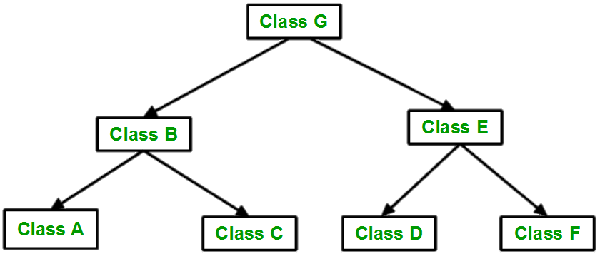
Hierarchical Inheritance:
In this type of inheritance, more than one sub class is inherited from a single base class. i.e. more than one derived class is created from a single base class.

Slide 54
#include <iostream>
using namespace std;
class Vehicle
{
public:
Vehicle()
{
cout << "This is a Vehicle" << endl;
}
}; // first sub class
class Car: public Vehicle
{
}; // second sub class
class Bus: public Vehicle
{
};
int main()
{
Car obj1;
Bus obj2;
return 0;
}

Slide 55
What is Encapsulation??
The wrapping up of data and functions into a single unit ( called class ) is known as encapsulation. Data encapsulation is the most striking feature of class.
The data is not accessible to the outside world, and only those functions which are wrapped in the class can access it. These functions provide the interface between the object’s data and the program.
It is the technique of making the fields in a class private and providing access to the fields via public methods.
Is also referred to as data hiding

Slide 56
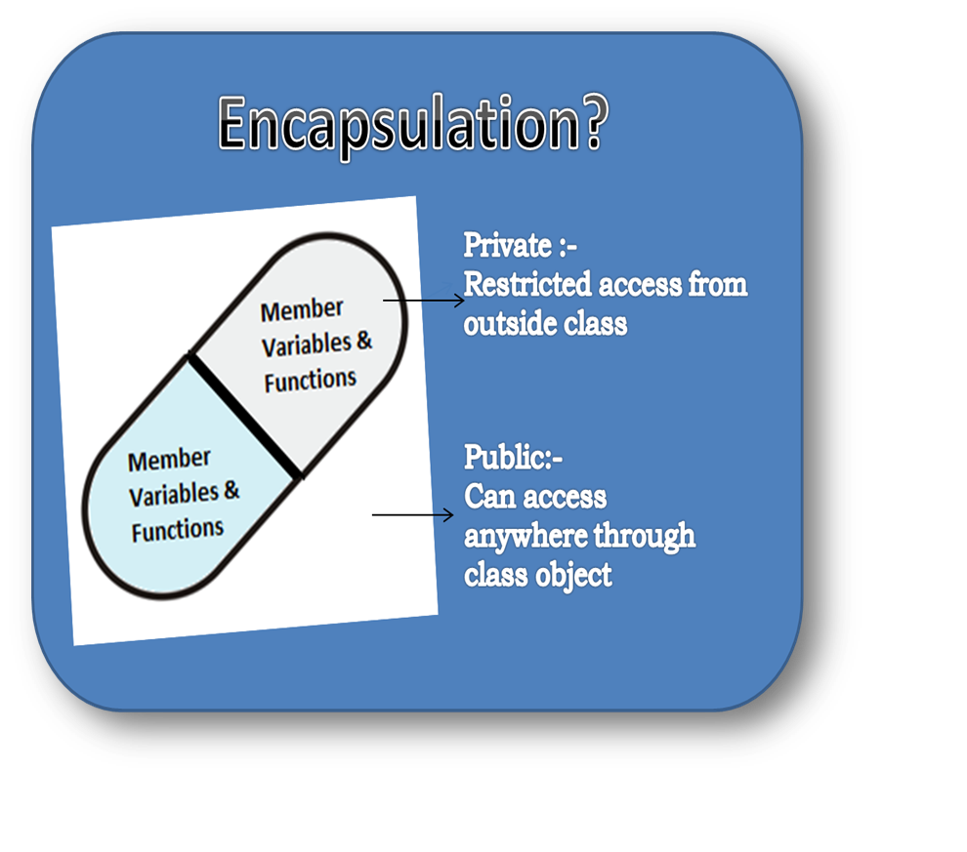
C++ program to explain encapsulation
#include<iostream>
using namespace std;
class Encapsulation
{
private:
int x;
public:
void set( int a)
{
x =a;
}
int get()
{
return x;
}
};
int main()
{
Encapsulation obj;
obj.set(5);
cout<<obj.get();
return 0;
}

Slide 57
Polymorphism..!!
The word polymorphism means having many forms. In simple words, we can define polymorphism as the ability of a message to be displayed in more than one form.
Real life example of polymorphism, a person at a same time can have different characteristic. Like a man at a same time is a father, a husband, a employee. So a same person posses have different behavior in different situations. This is called polymorphism.
Polymorphism is considered as one of the important features of Object Oriented Programming.
In C++ polymorphism is mainly divided into two types:
Compile time Polymorphism
Runtime Polymorphism

Slide 58
Compile time Polymorphism
Function overloading and Operator overloading are perfect example of Compile time polymorphism.
Compile time Polymorphism Example
In this example, we have two functions with same name but different number of arguments. Based on how many parameters we pass during function call determines which function is to be called, this is why it is considered as an example of polymorphism because in different conditions the output is different. Since, the call is determined during compile time thats why it is called compile time polymorphism.

Slide 59
Example:
#include <iostream>
using namespace std;
class Add
{
public:
int sum(int num1, int num2)
{
return num1+num2;
}
int sum(int num1, int num2, int num3)
{
return num1+num2+num3;
}
};
int main()
{
Add obj; //This will call the first function
cout<<"Output: "<<obj.sum(10, 20)<<endl; //This will call the second function
cout<<"Output: "<<obj.sum(11, 22, 33);
return 0;
}
Output:
Output: 30 Output: 66

Slide 60
2) Runtime Polymorphism
This type of polymorphism is achieved by Function Overriding.
Runtime Polymorphism Example
In case of function overriding we have two definitions of the same function, one is parent class and one in child class. The call to the function is determined at runtime to decide which definition of the function is to be called, thats the reason it is called runtime polymorphism.

Slide 61
Example of Runtime Polymorphism
#include <iostream>
using namespace std;
class A {
public: void disp(){
cout<<"Super Class Function"<<endl;
}
};
class B: public A{
public: void disp(){
cout<<"Sub Class Function";
}
};
int main() {
//Parent class object
A obj;
obj.disp();
//Child class object
B obj2;
obj2.disp();
return 0;
}
Output:
Super Class Function
Sub Class Function

Slide 62
CONSTRUCTOR:
Constructor is special member functions which initialize an object when it is created. It is special because its name is same as the class name.
Constructor is called automatically whenever an object of its class is created.
It is called constructor because it constructs the values of data members of the class.

Slide 63
PROPERTIES OF CONSTRUCTOR:
Constructor name is the same as the class name.
Constructor does not have a RETURN-TYPE , not even void , and they cannot return value.
Constructor implicit calls to NEW & DELETE when memory allocation is required.
Constructor should be declared in the PUBLIC section of the class.
Constructor cannot be virtual.

Slide 64
TYPES OF CONSTRUCTOR
DEFAULT CONSTRUCTOR
PARAMETERIZED CONSTRUCTOR
DEFAULT CONSTUCTOR:
Constructor that accepts NO PARAMETER is call default constructor.
If no constructor is defined then compiler supplies a default constructor.
PARAMETERIZED CONSTUCTOR
Constructor that accepts PARAMETERS is called as parameterized constructor.
While creating objects we must pass one or more parameters in order to invoke this constructor.

Slide 65
DEFAULT CONSTRUCTOR
#include<iostream.h>
#include<conio.h>
class Test
{
int x;
public:
Test() //constructor declared
{
x=9000;
}
};
void main()
{
clrscr();
Test t1,t2;
cout<<“x=”<<t1.x<<endl;
cout<<“x=”<<t2.x;
getch();
}

Slide 66
PARAMETERIZED CONSTRUCTOR
#include<iostream.h>
#include<conio.h>
class Test
{
public:
int a , b , c;
Test( int x, int y)
{
a=x;
b=y;
c=a+b;
}
};
void main()
{
clrscr();
Test t1(3000 , 5000);
cout<<“sum of A and B is:”<<t1.
getch();
}

Slide 67
DESTRUCTOR:
Destructor is a member function which DELETES an object.
Destructor has same name as the class name , preceded by a TILTED sign (~).
Destructors don’t take any argument and don’t return anything.

Slide 68
When DESTRUCTOR is
Called?
A destructor function is called AUTOMATICALLY when the object goes out of scope:
The function ends.
The program ends.
A block containing local variables ends.
A delete operator is called.

